Slide 1
Viability of a new location
Rui

Slide 2
Dataset
“Marketing campaign” from Kaggle
Nº rows: 2240
Nº columns: 29
Clients profile (DoB, Education, Marital Status, Income, Children, etc)
Amounts spent on different products
Response to Marketing Campaigns
Where purchases took place (Web, Store, Catalog)
Notes:
Idea: We have the clients profile, and the amount spent on products. With the demographic population and its distribution, and the proportion of clients that use our service, predict the investment cost/benefit for opening a new store for instance. Having into account the sharing of clients between our stores, the area affected by the previous one would be impacted.
https://www.pordata.pt/censos/resultados/populacao-lisboa-1288

Slide 3
Initial steps
Data cleaning
Identification of type of problem: Regression
Converting categorical columns into numerical
Label Encoding (“Education”)
One Hot Encoding - Dummy variables (“Marital Status”)
Features: 15
Target: ∑ amount spent on products

Slide 4
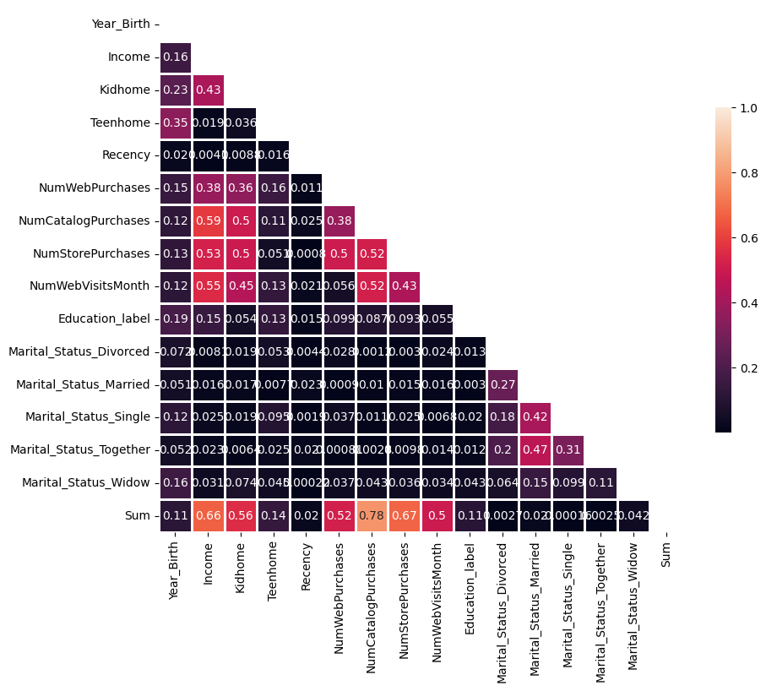
Quick EDA
Pairplot
Heatmap of correlations
All features - 15 features
Selected features - 8 features
(removing Marital Status, Recency and Number of Web Visits)

Slide 5
Initial model analysis
Determine estimator “type”
Train Test Split
All features
Train Test Split
Selected features
KNN Reg.
R² = 0.73
Linear Reg.
R² = 0.77
Decision Trees Reg.
R² = 0.83
KNN Reg.
R² = 0.72
Linear Reg.
R² = 0.77
Decision Trees Reg.
R² = 0.81
Standardizing
KNN Reg.
R² = 0.84
Linear Reg.
R² = 0.82
Decision Trees Reg.
R² = 0.84
* The values for the parameters were tested and “optimized” in the first instance and was kept consistent throughout the process

Slide 6
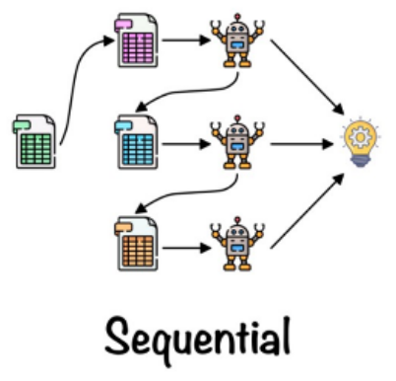
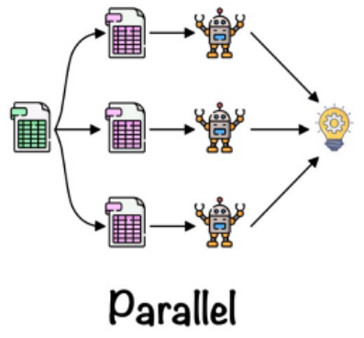

Ensemble methods and fine tuning
Decision Trees Reg.
R² = 0.84
Boosting
Bagging Reg.
(Decision Trees)
R² = 0.84
Pasting
(Decision Trees)
R² = 0.85
Random Forests
R² = 0.85
AdaBoost
(Decision Trees)
overfit
Gradient Boosting
overfit
XGBoost
overfit
Hyperparameter & CV
Grid or Random
Boosting
Random Forests
R² = 0.87
R²_train = 0.91
Hyperparameter & CV
Grid or Random
AdaBoost
(Random Forests)
R² = 0.85
R²_train = 0.90
AdaBoost
(Random Forests)
R² = 0.86

Slide 7
Next steps
Feed
RF
Demo
%
RF
Predictive Model
Gather demographic data
Analyse Proportion of Market
Predict Viability
Retrain the model with the entire dataset
Notes:
Idea: We have the clients profile, and the amount spent on products. With the demographic population and its distribution, and the proportion of clients that use our service, predict the investment cost/benefit for opening a new store for instance. Having into account the sharing of clients between our stores, the area affected by the previous one would be impacted.
https://www.pordata.pt/censos/resultados/populacao-lisboa-1288

Slide 8
Thank you

